Slide 2
Free Pike bridge repair project trt-m0032-01.42 city of Trotwood

Slide 3
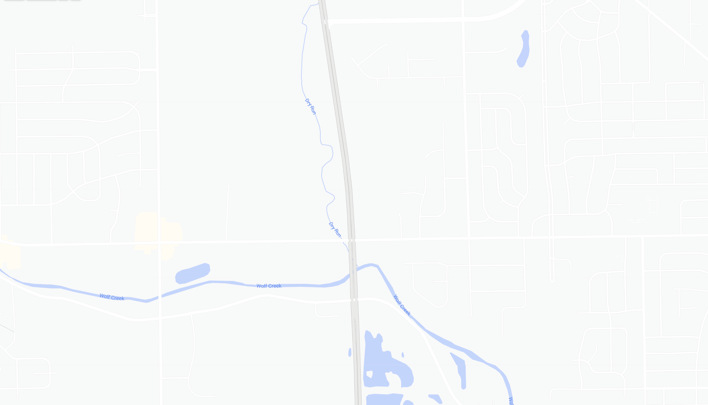
Aerial View
NORTH
TRUNER ROAD
STATE ROUTE 49
PROJECT
LIMITS
OLIVE ROAD
FREE PIKE
WOLF CREEK PIKE

Slide 4
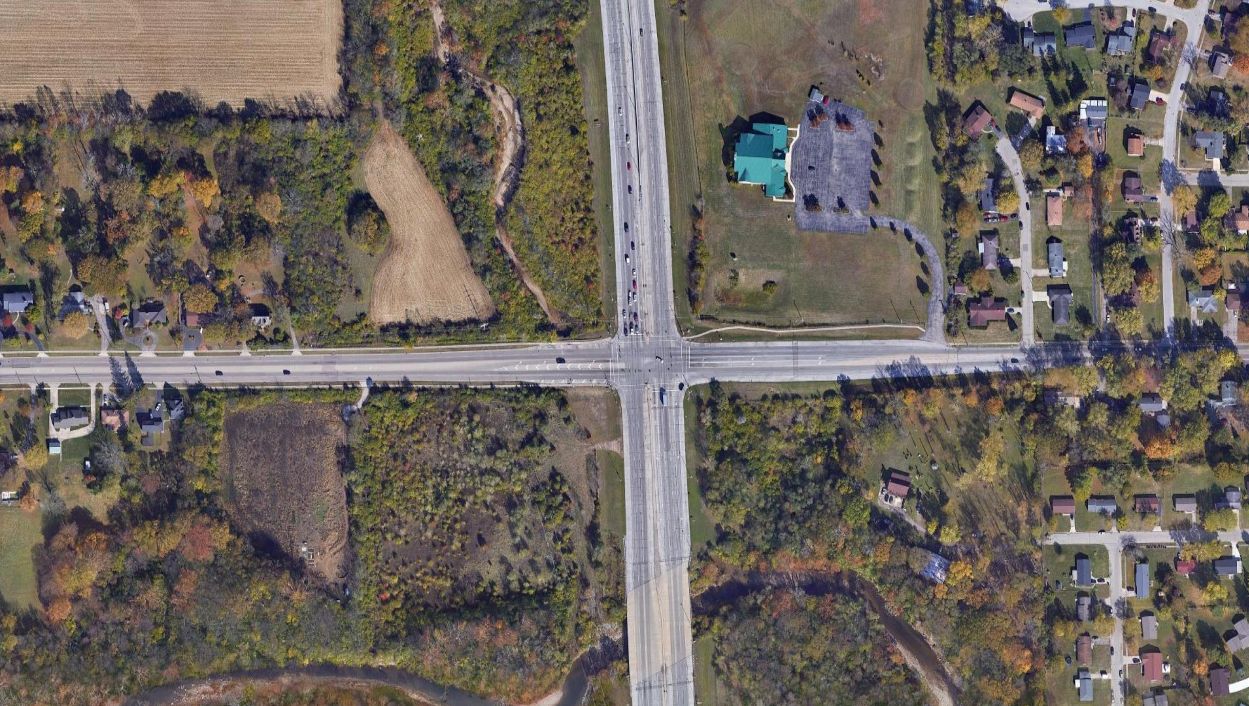
Aerial View
NORTH
DRY RUN
FREE PIKE
TRT-M0032-1.42
STATE ROUTE 49
WOLF CREEK

Slide 5
Project Background
Year Built: 1977
Structure Type: Two-span cast-in-place concrete frame
Project Goal: To repair the existing structural damage and loss of backfill due to scour below the bridge
Road Closure: Loss of backfill has caused pavement settlement. Loss of backfill may cause complete pavement failure resulting in a deep hole opening up in the road

Slide 6
Project Scope
Repair of Existing Structure
Restoration of Backfill
Replacement of Pavement
Installation of Waterproofing
Installation of Scour Prevention Measures

Slide 7
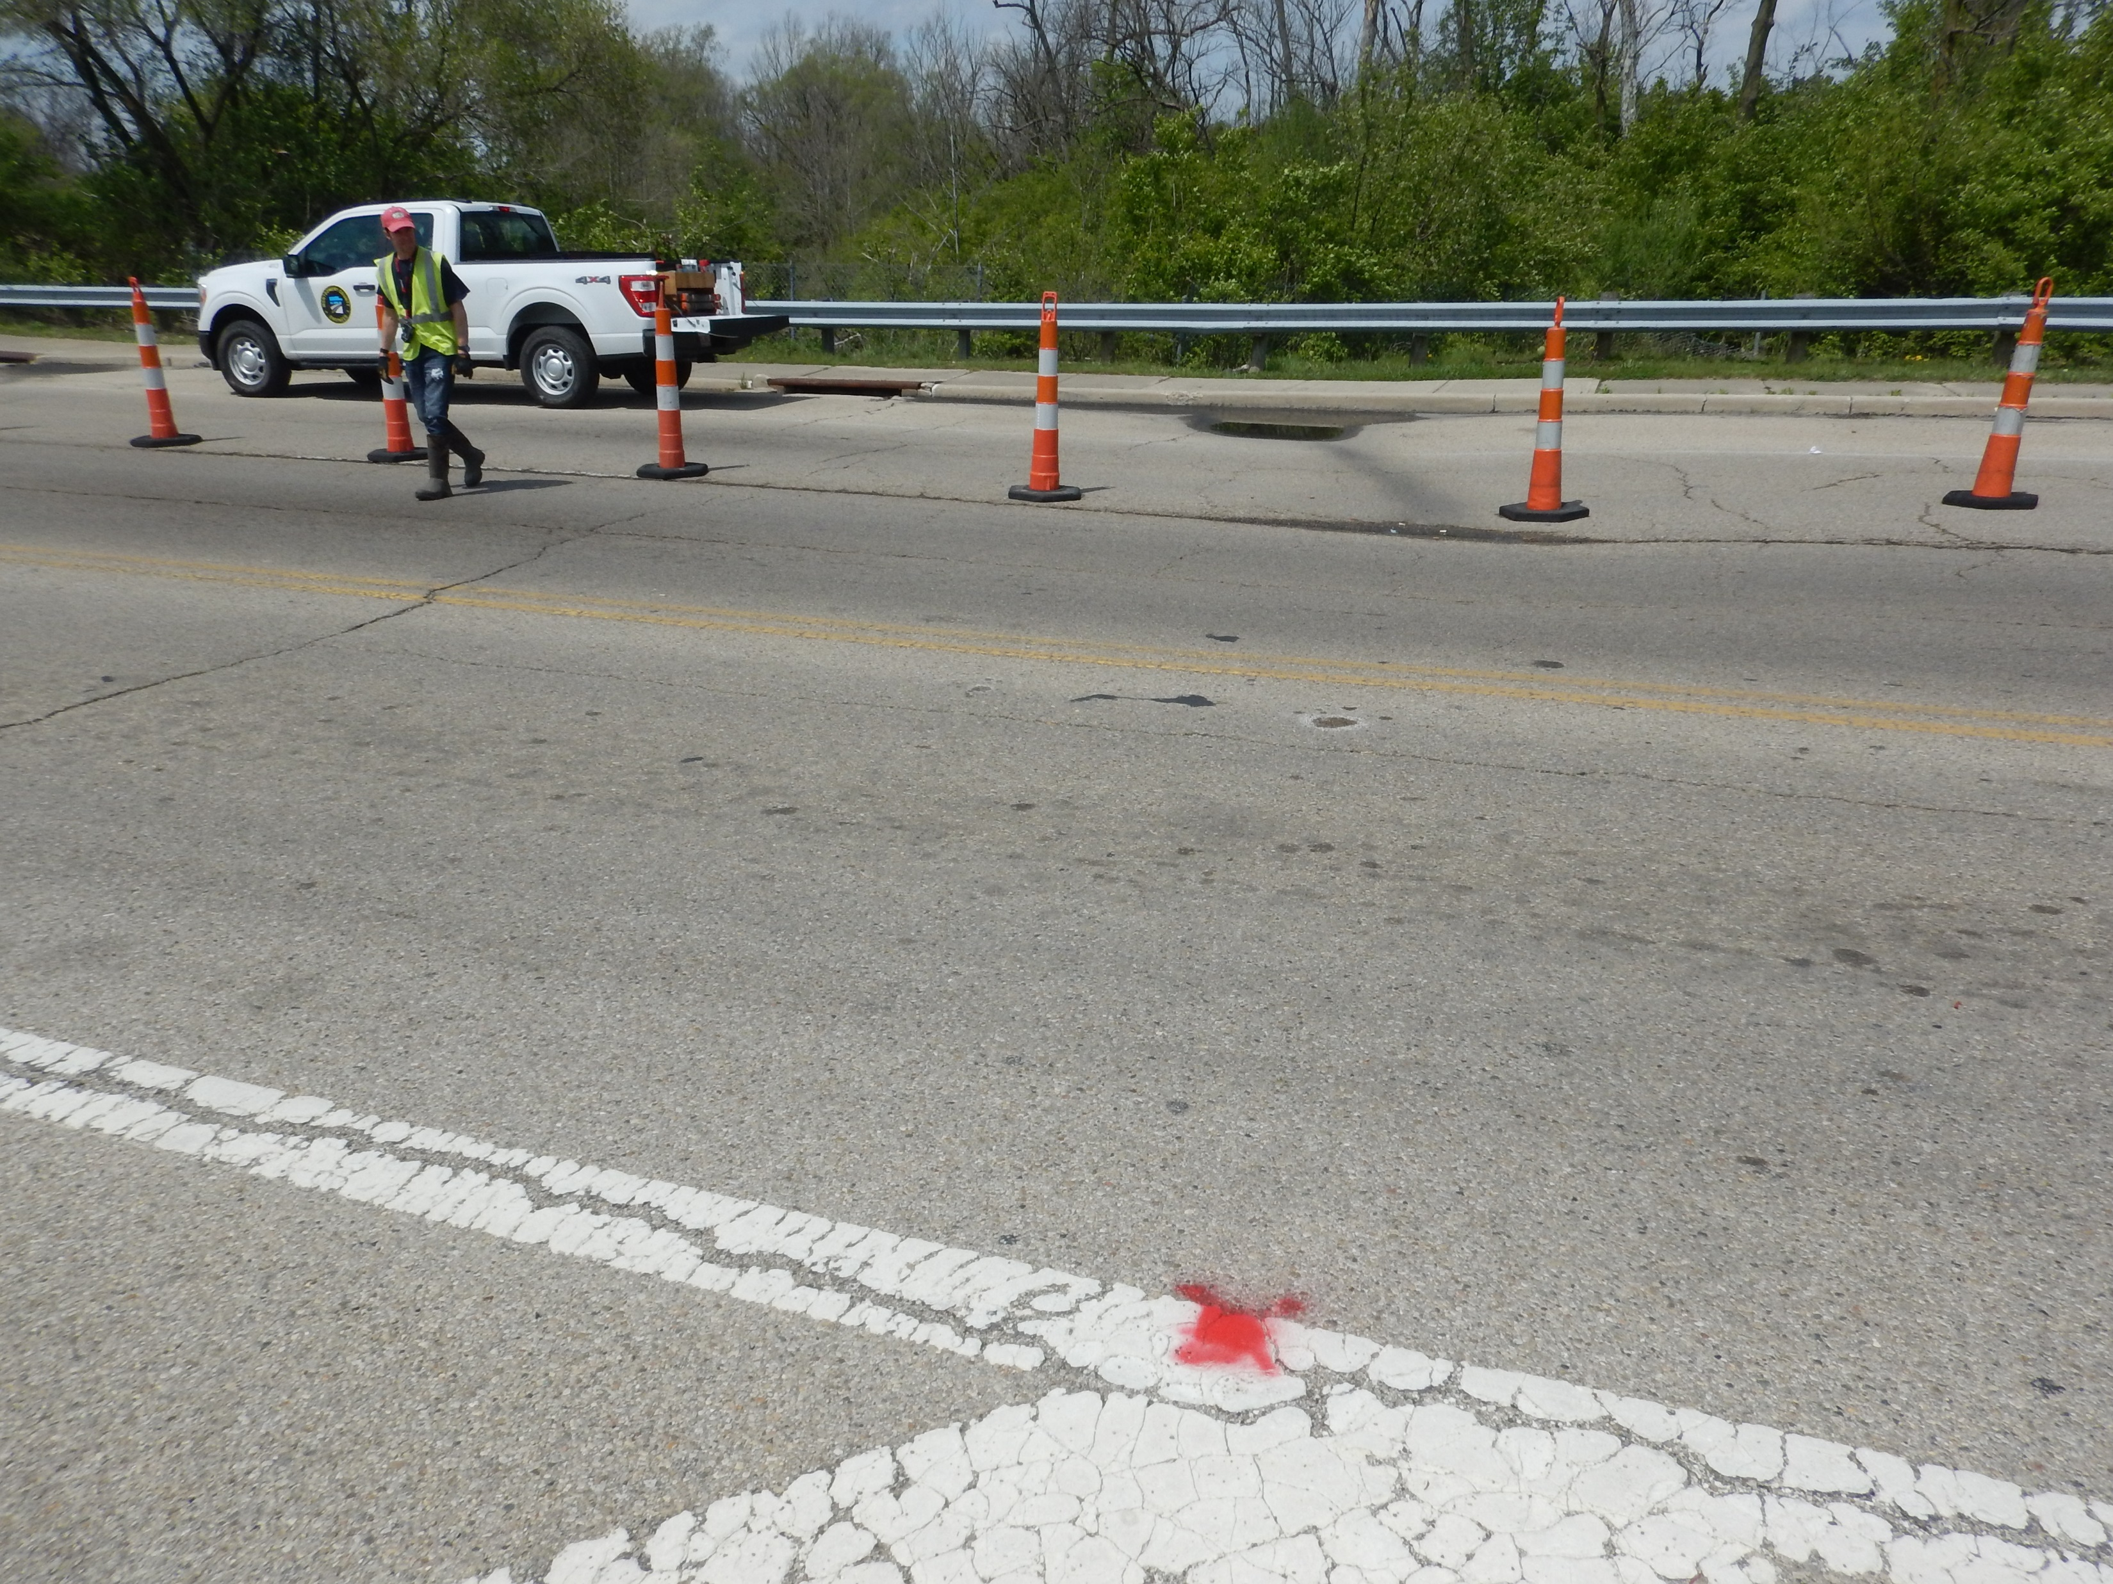
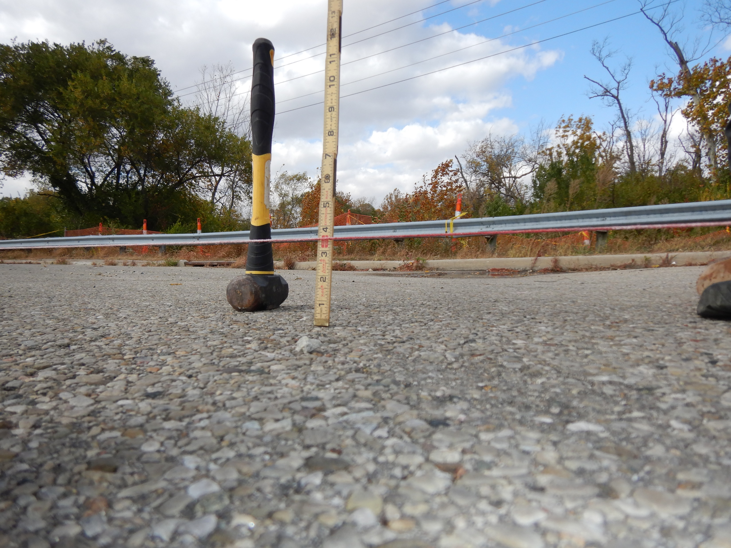
Existing Condition
Pavement has settled approximately 3.5 inches in the area behind the structure. This settlement can be attributed to the loss of fill behind the walls of the structure.

Slide 8
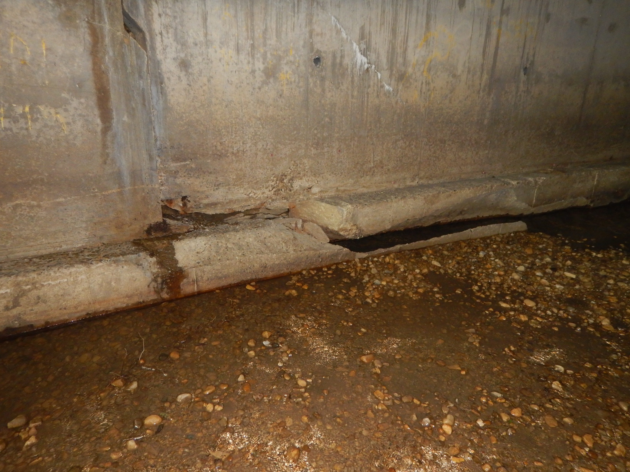
Existing Condition
Approximately 6 inches of settlement has occurred in portions of the structure.

Slide 9
Project site and
impacted properties
NORTH

Slide 10
#1 Denlinger, Dennis R. & Theresa
NORTH
Acquisition of 0.279 acres of Temporary Easement on the north side of the road is necessary for access under the bridge for construction.

Slide 11
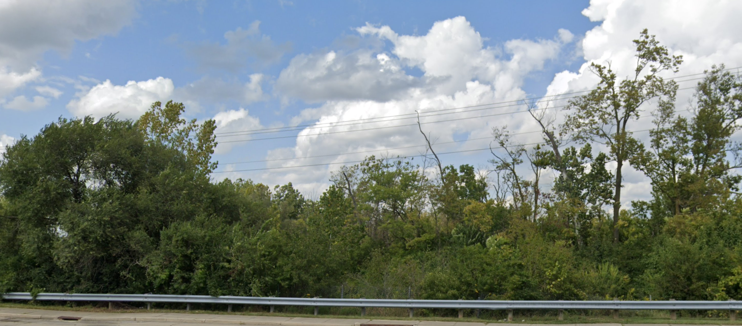
#1 D enlinger, Dennis R. & Theresa

Slide 12
PROJECT COSTS
Construction Engineering: by MCE
Right-of-Way: $ 300.00
Design Build Document Preparation: $ 65,051.00
Construction: $ 576,450.00
Total Project Costs: $ 641,801.00

Slide 13
PROJECT SCHEDULE
Road Closed: May 5, 2022
Design-Build Document Preparation: May 5, 2022 – October 10, 2022
Right-of-Way Acquisition: November 2022 – January 2023
Advertise & Award: March 2023 – April 2023
Design & Construction: June 2023– September 29, 2023*
* The road is required by contract to be open by September 29, 2023. Some minor construction activity, such as planting grass, may occur after the road is open. Final contract completion date is scheduled for October 27, 2023.

